Slide 1

DAA PROJECT
TEAM - PERFECT DEALERS
K.Vishnu Sainadh – BL.EN.U4AIE19028
K.Satwik - BL.EN.U4AIE19034
V.Ashrith - BL.EN.U4AIE19066

Slide 2
PROBLEM STATEMENT
A firm has divided its marketing area into n zones. The amount of sales depends upon the number of the salesman in each zone. The firm has been collecting the data regarding sales and salesman in each area over a number of past years. For the next year firm has only x number of salesman and the problem is to allocate these salesman to n different zones so that the total sales are maximum.

Slide 3
APPROACH
Dynamic Programming
Optimization over plain recursion
Can be divided into sub-problems
Tabular presentation
Optimality at each stage
Overall optimality

Slide 4
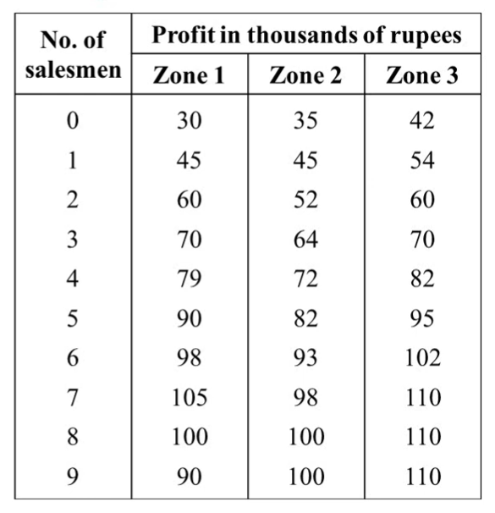
SOLVING WITH AN EXAMPLE
Assumptions:
X1, X2 and X3 be the number of salesmen allocated to zone 1, zone 2 and zone 3
f1(X1), f2(X2) and f3(X3) be the profits from zone 1, zone 2 and zone 3

Slide 5
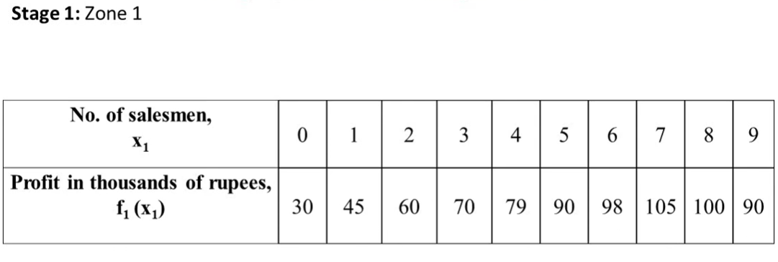
STAGE - 1

Slide 6
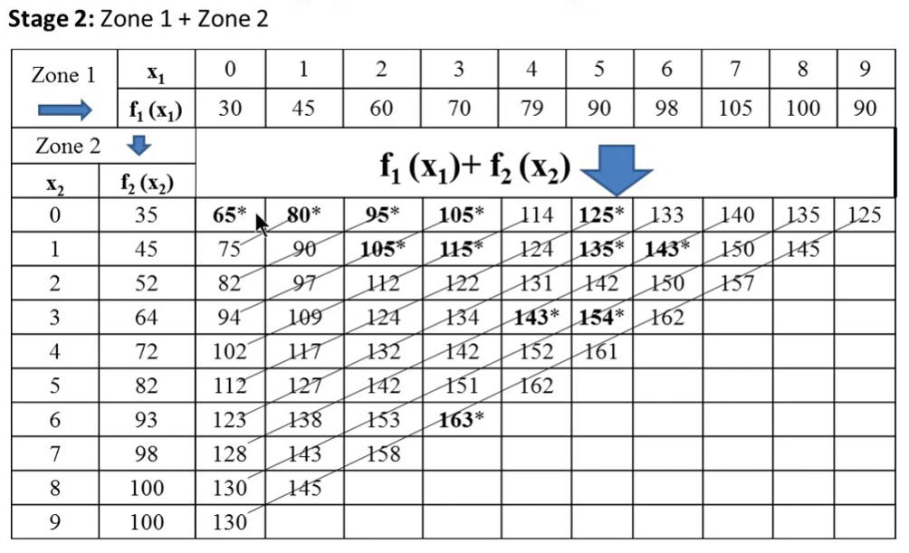
STAGE - 2

Slide 7
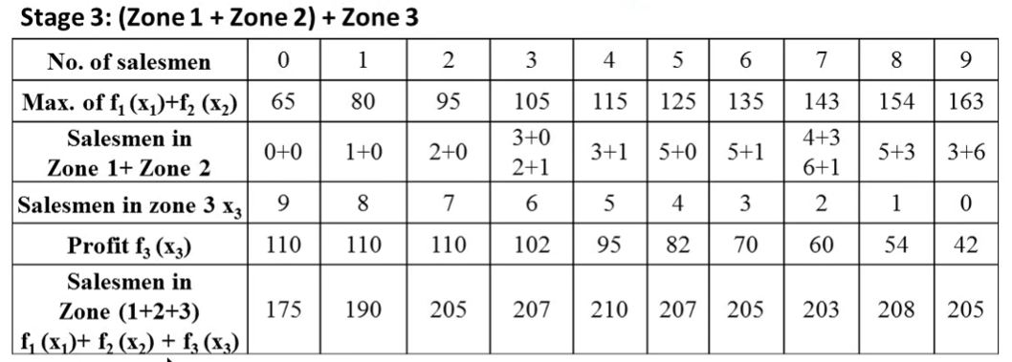
STAGE - 3

Slide 8
WHY DYNAMIC PROGRAMMING ?
We make decision at each step considering current problem and solution to previously solved sub problem to calculate optimal solution
Why not greedy ?
The greedy method computes its solution by making its choices in a serial forward fashion, never looking back or revising previous choices.

Slide 9
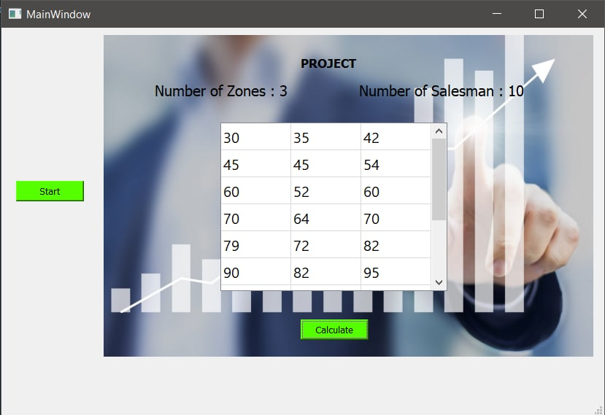
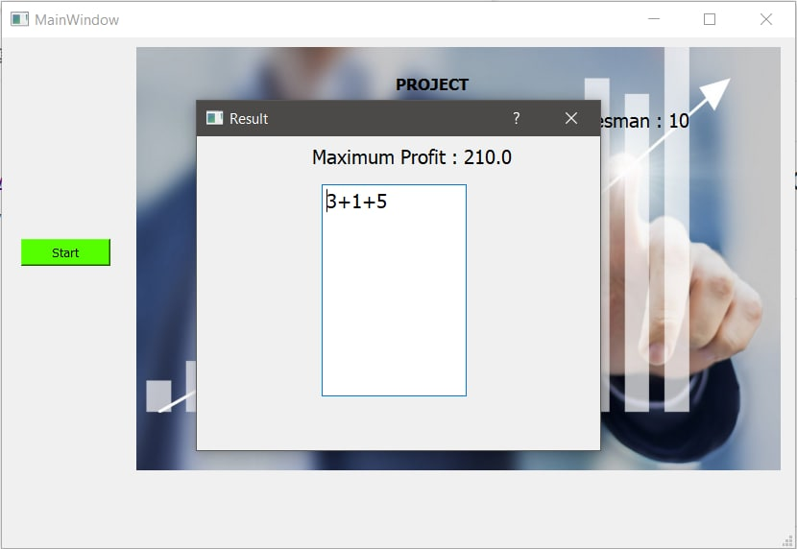
OUTPUT

Slide 10
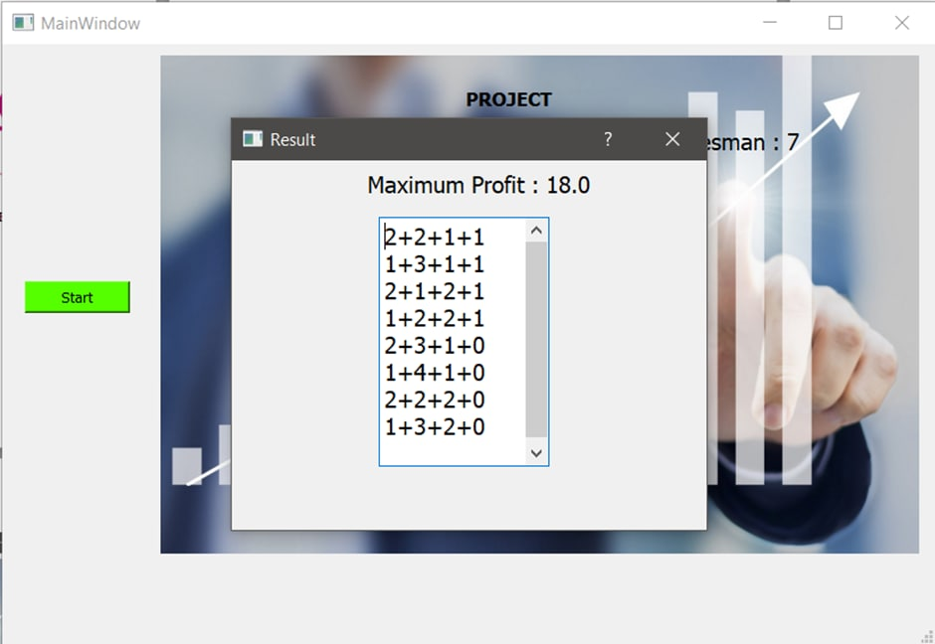
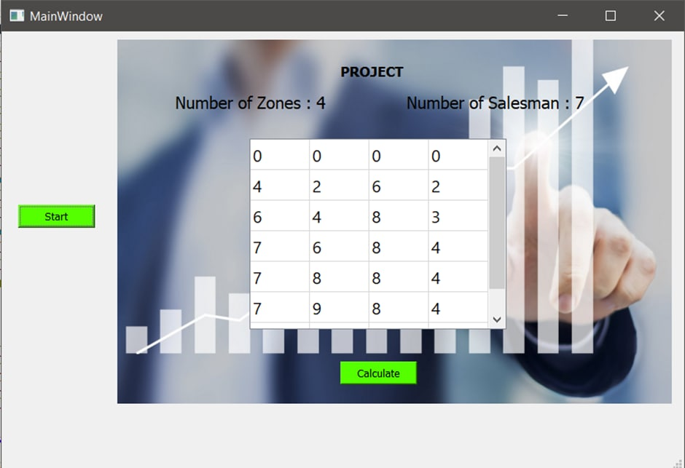
OUTPUT

Slide 11
LET'S SEE OUR IMPLEMENTATION

